Slide 1
Unit 2 review
Multiplication of Decimals

Slide 2
#1
Robin earns $10.85 an hour babysitting her cousins. She works 4 hours on Friday and 4 more hours on Saturday. Write an expression that can be used to determine how much she earned working this weekend.

Slide 3
#2
The fifth grade teachers went to Chuys for dinner. They split the bill evenly between the 9 of them and each paid $6.49. What was the total bill before they split it?

Slide 4
#3
A popsicle costs $0.32. How much will it cost to purchase 8? Draw a model to help solve.

Slide 5
#4
What is the perimeter of the square?
8.2 in

Slide 6
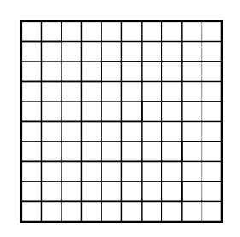
#5
What expression is represented by the model below?

Slide 7
#6
What is the multiplication sentence shown by the model below?

Slide 8
#7
Miss English went to 15 pokestops this weekend. At each pokestop she caught 20 pokemon. How many pokemon did she catch altogether?

Slide 9
#8
What are the first six multiples of the number 9?

Slide 10
#9
Create a list showing all the factors for 40. (Use the factor chart to help you.)

Slide 11
#10
Miss English played a decimal relay game with each of her classes. The fastest time was 29.76 seconds. What is this time rounded to the nearest second?

Slide 12
#11
Erik sold his Aunt $14.67 worth of items for the fundraiser. She paid him with a $20.00 bill. How much change should he give her?

Slide 13
#12
Casey wants to take 12 friends to Cinemark for her birthday party. Each ticket will cost 8.50. She needs to tell her mom how much the party is going to cost. How can she solve the problem? Write an expression.

Slide 14
#13
Write a number with the digit 7 in the hundredths place.

Slide 15
#14
Solve for the following expression:
0.63 x 4

